Slide 1

Getting Started on HoloLens
www.infernored.com @infernoredtech

Slide 2
Matt Wilhelm
Developing Xamarin for 5 years
Specialize in cross platform architecture
Android/iOS UI/UX
Web development
ASP.Net, WPF, UWP
C++, Java, JavaScript, Objective-C, etc…
community@AddressXception.com
Github.com/AddressXception @AddressXception

Slide 3
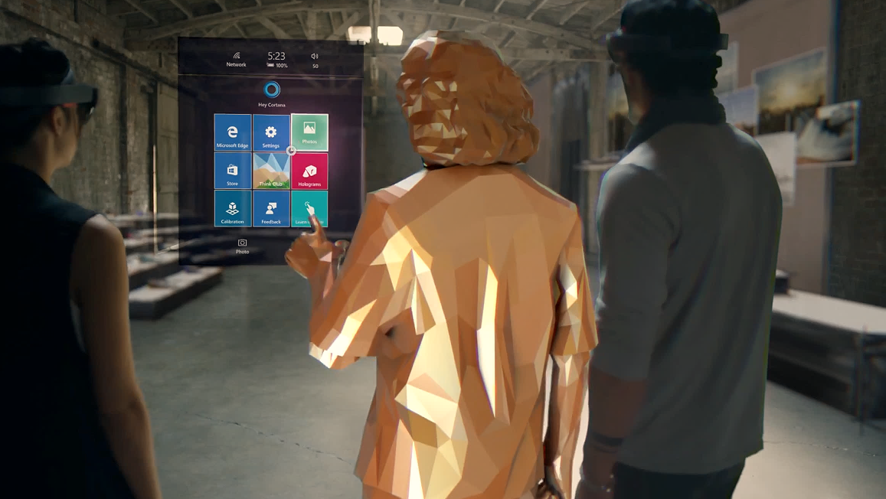
What We’ll Cover
Setting up your dev environment
Application programming model
Getting a UWP app ready for HoloLens
Quick refresher on Unity
Adding a unity scene to our app
Communicating between windows

Slide 4


Get The Tools
https://developer.microsoft.com/en-us/windows/holographic/install_the_tools
VS 2015 Update 3
HoloLens Emulator
Unity HoloLens Technical Preview
Actually you want the 5.5 Beta
64-Bit Win 10 Pro or greater.
8Gb RAM. Hyper-V

Slide 5
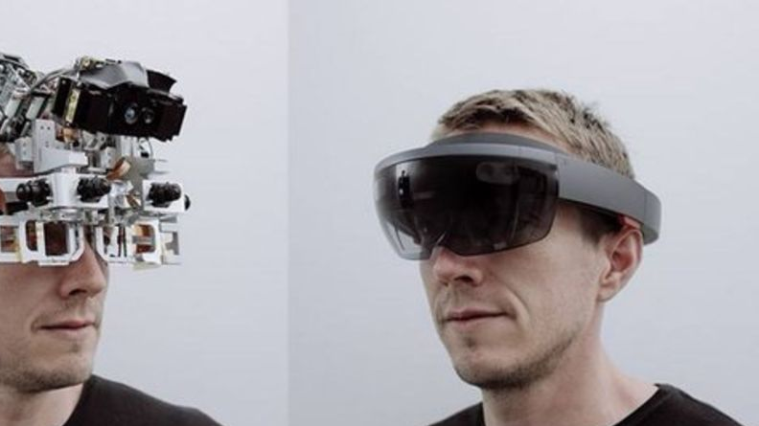
The Hardware
Intel Atom x5-1.04 GHz 64-bit capable
2GB RAM, 64GB ROM
Windows 10 32-Bit
Waveguides for lenses
> 2.5k radiants (light points per radian)
4 Environmental Cameras, 4 microphones
1 depth camera
Ambint light sensor, accelerometer
Notes:
Hardware get official doc info

Slide 6
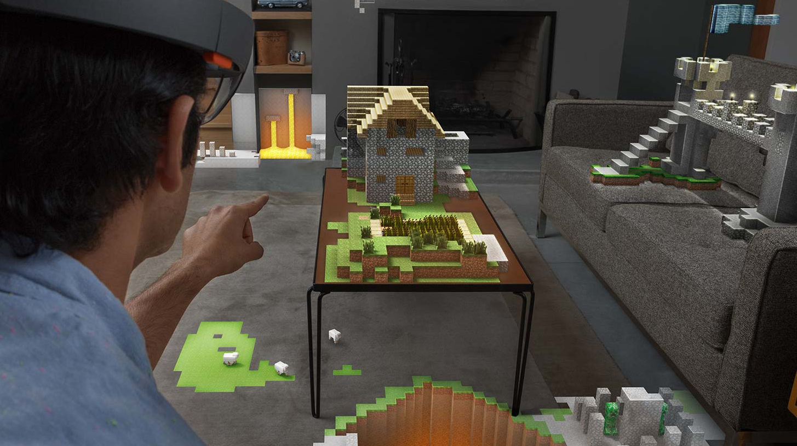
The Basics – Input & Interaction
Gaze – a floating pointer that behaves similar to a mouse cursor
Gesture – Two basic gestures: Bloom & Tap
Can combine press & hold with hand movement to make more complex interactions
Voice – “Hey Cortana”
Very limited in noisy environments but very powerful for complex interactions
Can offload voice commands to API’s for complex natural language processing (LUIS)
https://developer.microsoft.com/en-us/windows/holographic/development_overview

Slide 7
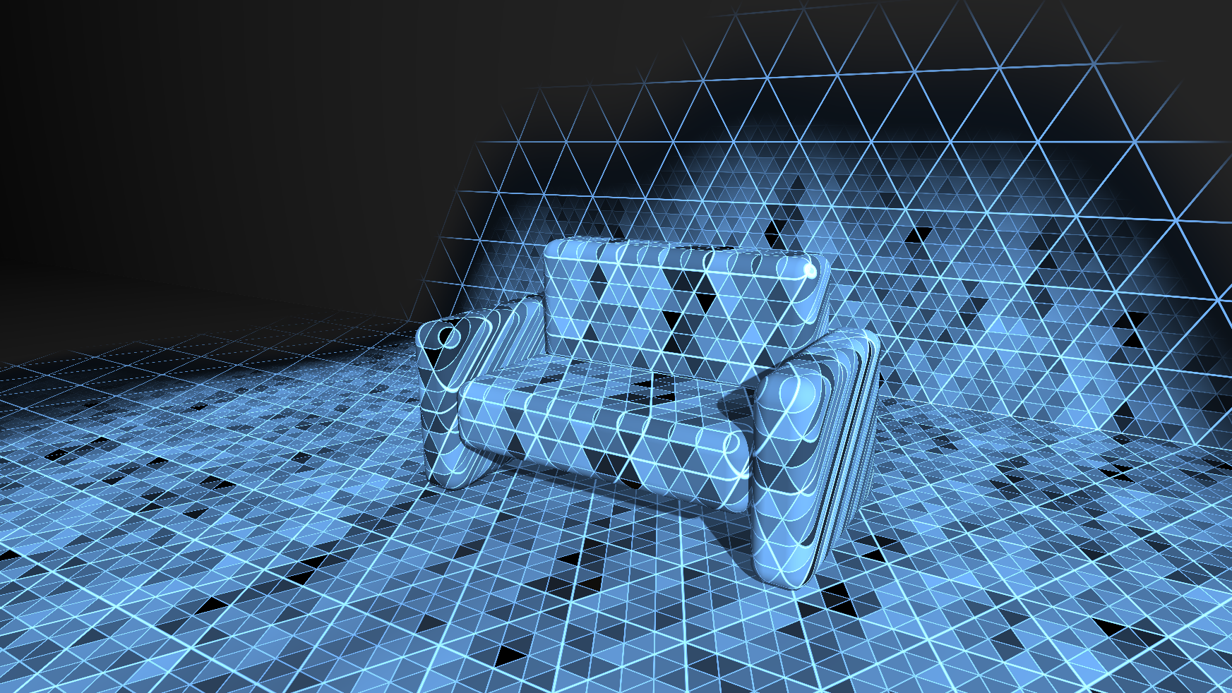
The Basics – Spatial Mapping
HoloLens uses triangle meshes to represent space
Caching and processing meshes is resource intensive
Occlusion – when an object is hidden behind a real world object
https://developer.microsoft.com/en-us/windows/holographic/spatial_mapping

Slide 8
The Basics - Coordinate Systems
Stationary frame of reference – or “world coordinates”
Constantly refined over time
Spatial Anchors
The “world coordinates” are not absolute
Create their own coordinate system
Can place other objects in relation to an anchor – so they retain relative positions
Shared holographic experiences
https://developer.microsoft.com/en-us/windows/holographic/coordinate_systems

Slide 9
The Basics – Holographic View
No Shell, Cortana will try to notify with audio
You are responsible for all input
It’s all very technical – Windows.Graphics.Holographic
HolographicSpace
HolographicFrame
HolographicCamera

Slide 10
The Basics – 2D Apps
It’s just UWP
Building XAML experiences is similar to xBox’s 10 foot experience
1280x720, 150%DPI (853x480 effective pixels)
Information density comparable to a tablet
Can use ApplicationViewSwitcher api’s to spawn new views
Know the limitations
https://developer.microsoft.com/en-us/windows/holographic/current_limitations_for_apps_using_apis_from_the_shell

Slide 11
UWP App for HoloLens Demo
Target the universal platform
Device Family
Select View at runtime for the platform
Desktop XAML View
HoloLens XAML View
Notes:
Walk through converting a regular desktop UWP app (hint: it’s really easy)

Slide 12
The Basics – Unity
Use C# as a scripting language
MonoBehaviour
Project Setup
Prefabs
Meshes
Some basic patterns

Slide 13
Configure Unity for HoloLens
Set Main Camera Transform Position
Position = 0,0,0
Clear Flags = Solid Color
Background = RGBA 0,0,0,0 (Black)
Clipping Planes – Near = 0.85m
https://developer.microsoft.com/en-us/windows/holographic/unity_development_overview
Just copy it from the HoloToolKit
https://github.com/Microsoft/HoloToolkit-Unity

Slide 14
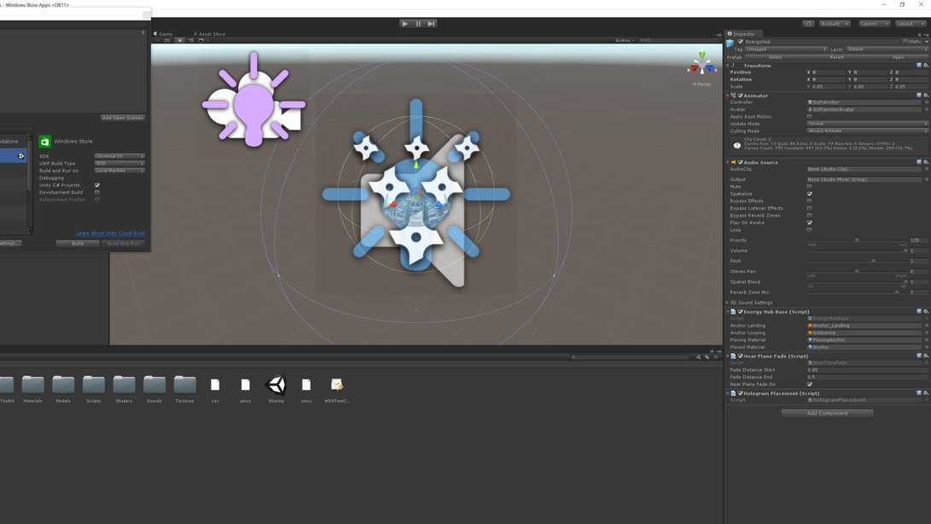
Configure Unity for HoloLens
Build UWP
File > Build Settings > Windows Store
SDK > 10
Build Type > XAML
Modify Quality for Frame Rate
Edit > Project Settings > Quality
Windows Store > Fastest
Configure for VR/AR
Build Settings > Player Settings
Windows Store > Other Settings > VR Supported

Slide 15
Debugging
Debug through visual studio
Using Holographic Remoting Player
https://developer.microsoft.com/en-us/windows/holographic/holographic_remoting_player

Slide 16
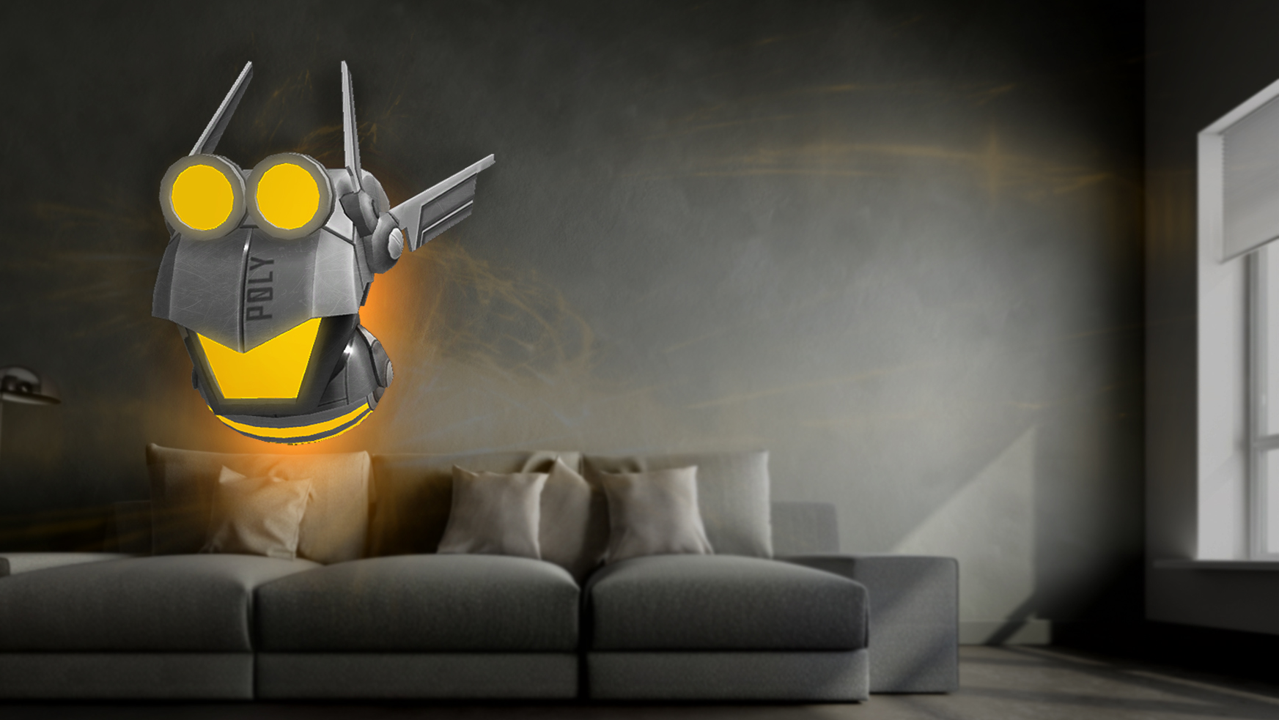
Add a 3D Scene Demo
Create a 3 Dimensional Scene
Debug in unity
Export project as Xaml
Open in visual studio

Slide 17
Connecting Unity to our App
Bring the regular UWP resources into unity sln
Shared projects, file linking, or other code sharing
Use applicationviewswitcher
https://mtaulty.com/2015/09/16/m_15940/
https://blogs.windows.com/buildingapps/2016/09/15/unity-interop-and-app-extensibility-app-dev-on-xbox-series/

Slide 18
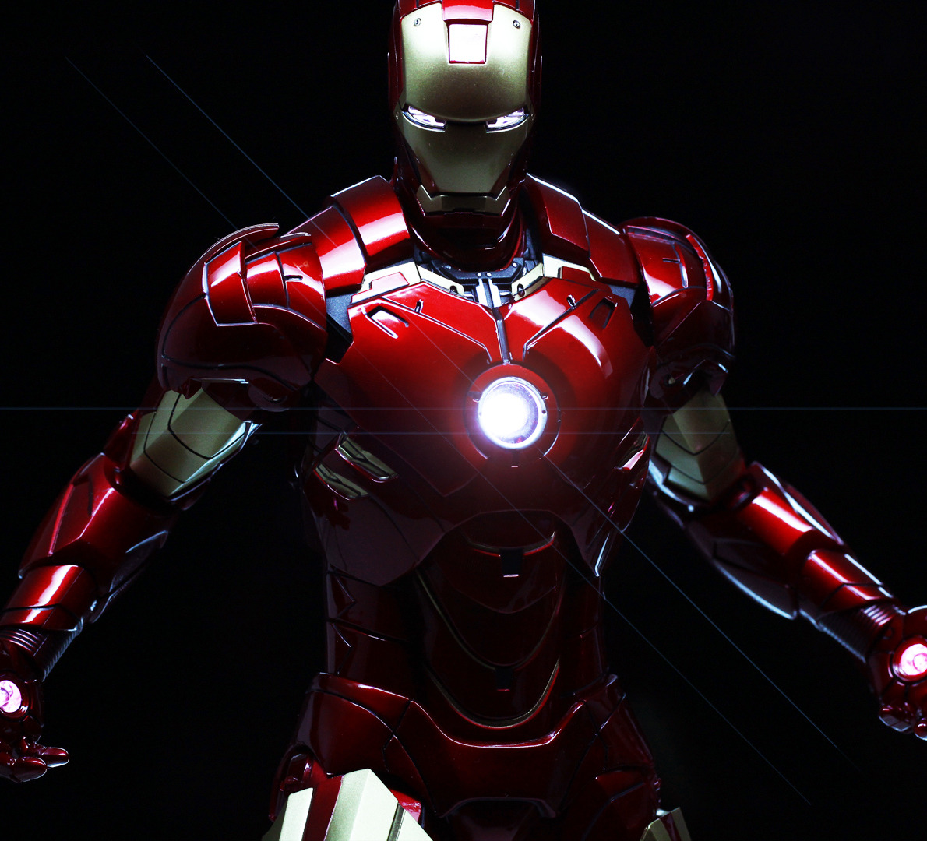
Interop
Modify PickCharacter
Pass character data to the view
SetSelectedCharacter

Slide 19
Questions?

